Slide 1

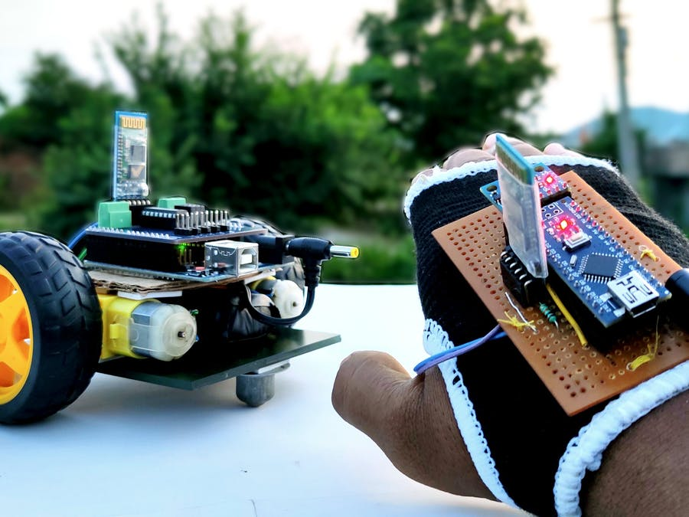
hand GESTURE CONTROL CAR
GROUP MEMBERS
SUNNY (19BEM1047)
NANDAN KUMAR (20BEM8010)
PARTHA PARBIR MOHAPATRA (20BEM8002)
FRANCK LEONEL (19BEM1058)

Slide 2

INTRODUCTION
Many parameters of robot are designed according to requirement. There are different ways to control robotic arm like Voice Controlled, Keypad Control, Gesture Control, etc. I finally come out with a hand gestures recognition automation. All the movements of this automated car are controlled by different activities that a user performs, cars movement can be easily controlled.
As human actions are involved in controlling movement, this car can be easily controlled. Sensors are used to detect the gestures of hand .and to transmit the data transmitter and receiver module is used. The exact movements are interpreted by Arduino uno and accelerometer.

Slide 3
OBJECTIVE OF THE PROJECT
Our objective is to make this device simple as well as cheap so it can be produced and used for number of purposes.
The objective of this project is to build a car that can be controlled by gesture wirelessly. In this project user is also able to control motions of the car by wearing controller glove and performing predefined gestures. This can be also used in many potential applications such as wireless controller car
Mainly the robot using the accelerometer with the help of human hand tilting. Accelerometer signals are received and assisted. The car moves depends upon the signal made by your hand and from a separation.

Slide 4
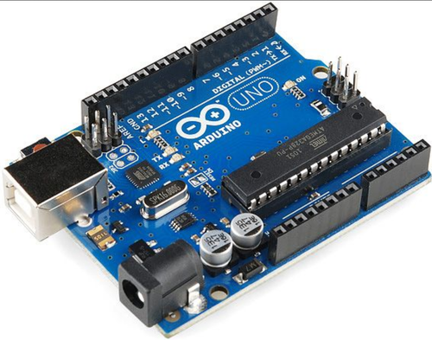
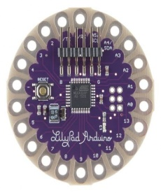
NEED OF COMPONENT
ARDUINO (UNO)
HC-O5 (BLUETOOTH MODULE)
DC MOTOR
MOTOR DRIVER (L298N)
MPU6050 (ACCELEROMETER)
BATTERY(9-12V)
WHEELS
JUMPER WIRES

Slide 5
ARDUINO UNO
Arduino Uno It is a microcontroller board based on ATmega328 which has 14 digital i/o and 6 analog pins. It has everything that is needed to support the microcontroller. Simply connect it to the computer with a USB cable to get started with the Arduino Uno board. It is flexible, easy to use hardware and software. Arduino Uno can sense the environment by receiving input from a variety of sensors and can affect its surroundings by controlling lights, motors, and other actuators.

Slide 6
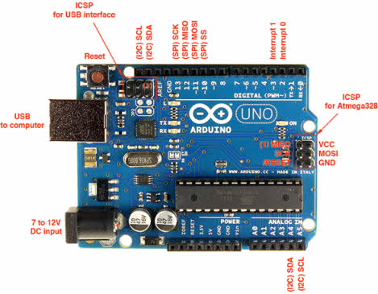
Arduino

Slide 7
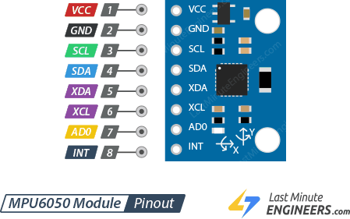
ACCELEROMETER(MPU6050)
Accelerometer is a device that allows for measuring the changes in orientation that take place around in a reference axis Here we used 6 axis gyroscope then therefore a sensor with 6 degrees of freedom , since it has three axes to measure the rate of turn and another three axes to measures the acceleration . As u say it combines the 3 Cartesian coordinate axis accelerometer and that takes gyroscopic measurements along these three axes pitch ,roll ,yaw.

Slide 8
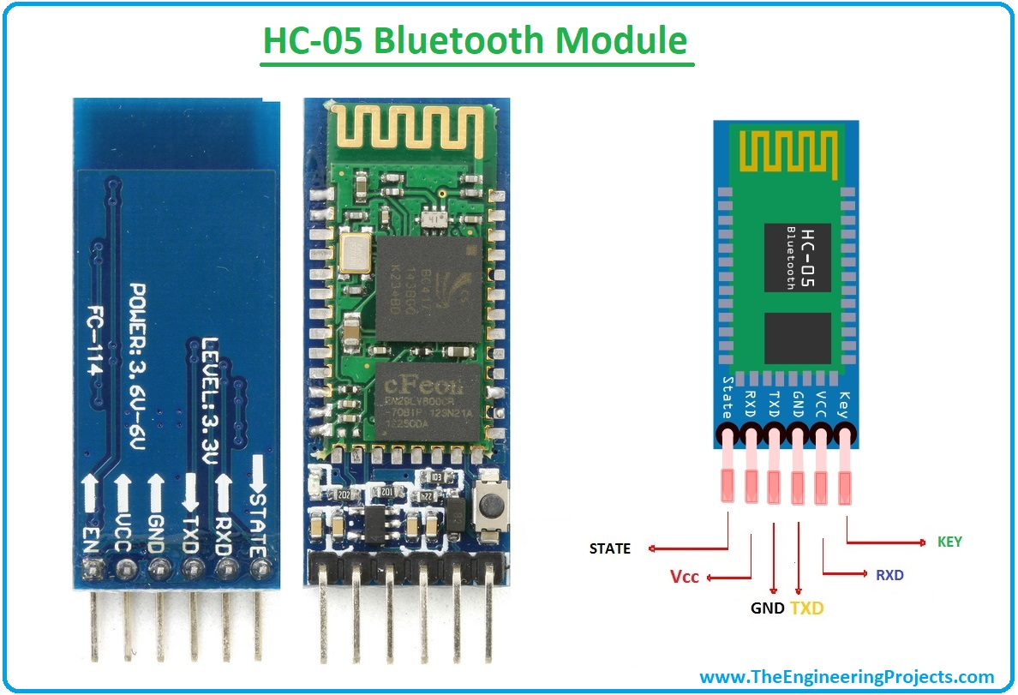
BLUETOOTH(HC-05)
HC-05 Bluetooth Module is an easy to use Bluetooth SPP (Serial Port Protocol) module, designed for transparent wireless serial connection setup. Its communication is via serial communication which makes an easy way to interface with controller or PC. HC-05 Bluetooth module provides switching mode between master and slave mode which means it able to use neither receiving nor transmitting data.

Slide 9
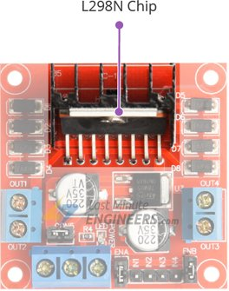
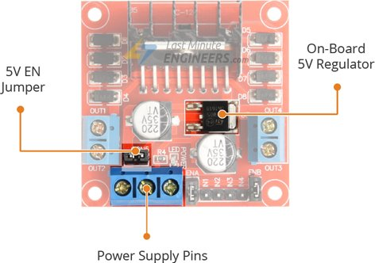
MOTOR DRIVER (L298)
This l298n motor driver module is a high power motor driver module for driving dc and stepper motors.
The l298n motor driver module consists of an l298 motor driver IC 78M05 voltage regulator, resistors, capacitor, power led, 5v jumper in an integrated circuit. M05 voltage regulator will be enabled only when the jumper is placed.
At the heart of the module is the big, black chip with chunky heat sink is an L298N.a dual-channel H-Bridge motor driver capable of driving a pair of DC motors.

Slide 10
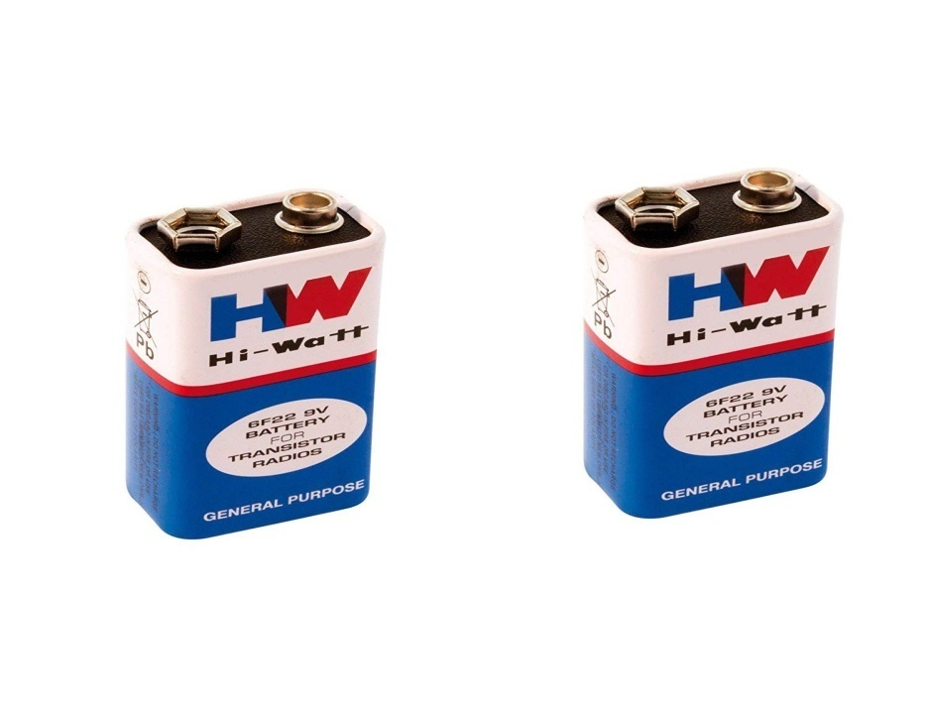
BATTERY
A battery is a device consisting of one or more electrochemical cells. A battery is device that directly converts chemical energy to the electrical energy. The purpose of battery is to supply 9 -12 volts to operate DC motors.

Slide 11
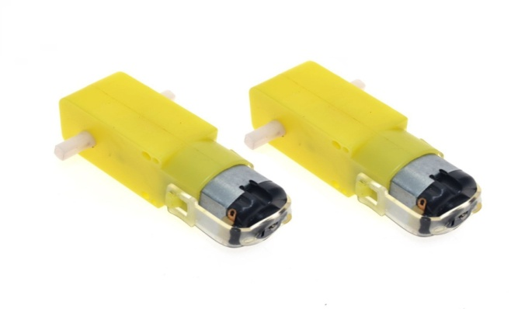
DC MOTOR
DC motor is used for the conversion of direct current into mechanical motion. The mechanical motion could be rotary or linear. The operation of DC motor is based on the principle that when a current carrying conductor is placed in a magnetic field, the conductor experiences a mechanical force. The speed of a DC motor can be controlled by changing the voltage applied to the armature or by changing the field current. DC motors can be used for the movement of the robotic car.

Slide 12
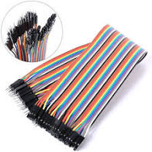
JUMPERWIRES
Jumper wires are used to connect two points in a circuit. All Electronics stocks jumper wire in a variety of lengths and assortments. Frequently used with breadboards and other prototyping tools in order to make it easy to change a circuit as needed.
Male jumpers are designed to plug securely into the holes in a breadboard. Female jumpers are useful for connecting male header posts and pin terminals on components. Jumpers are available in female-female, male-male and male-female configurations.

Slide 13
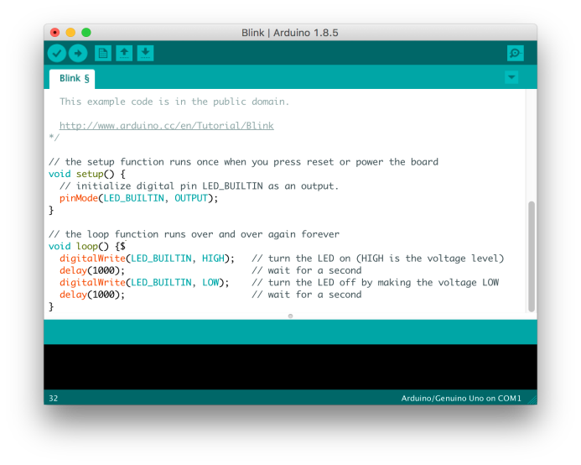
SOFTWARE DEVELOPMENT
ARDUINO (IDE )software has been used as the interface between software and hardware of this project. microcontroller needs a program to operate and execute the process associated with proposed design. It is easy to verify and compile after writing the code .
Here, It connects to the ARDUINO hardware to upload programs. But before upload the program there is a need to select appropriate microcontroller like ARDUINO UNO and ARDUNO LILYPAD from the Tool menu has been chosen. And for proper communication with computer and ARDUINO boards there is a need to select COM port from the tool menu.

Slide 14
BLOCK DIAGRAM .1
HC-05
(Blutooth
Module)
TRANSMITTER PART
ARDUINO(UNO)
MPU6050
(Accelerometer
And
Gyroscope
module )
Battery
(9-12)v

Slide 15
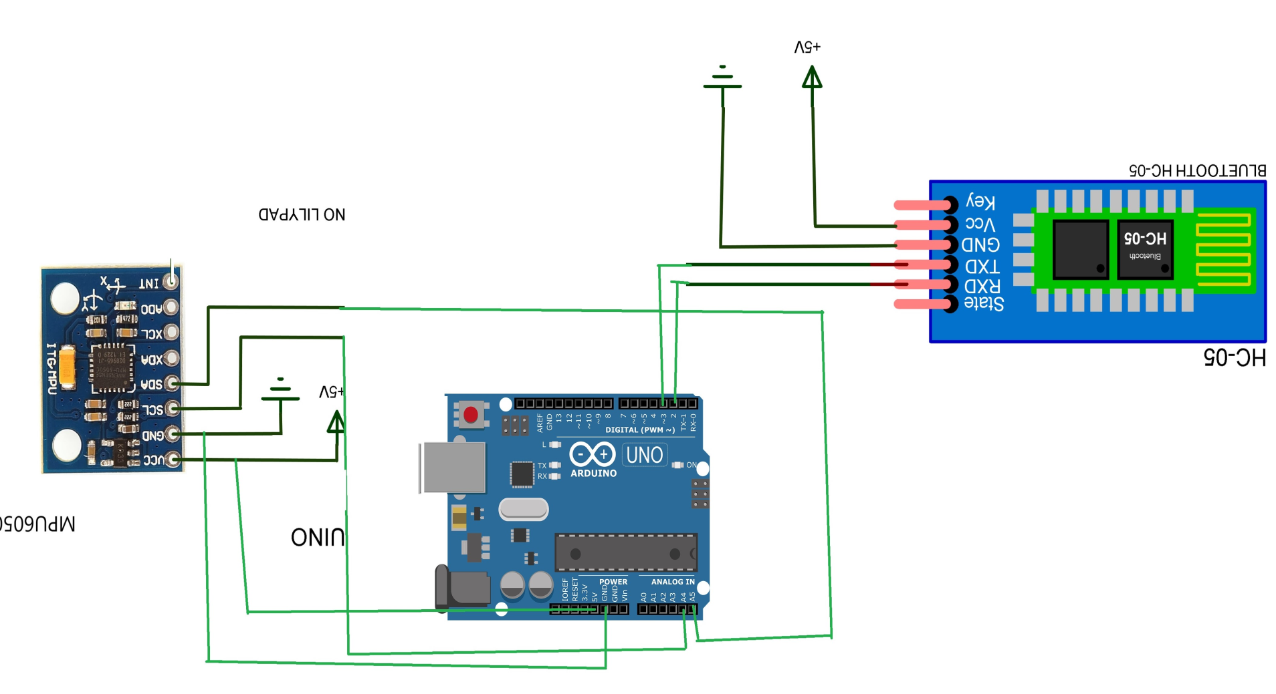
CIRCUIT DIAGRAM

Slide 16
WORKING OF TRANSMITTER PART
In transmitter circuit we have Arduino UNO with the accelerometer and with a encoder like our bluetooth.
Here first step is to recognize and detect the movements of hand by using Accelerometer MPU6050 and the position of hand is identified by using x and y scale. this data is supplied to Arduino Lilypad. Arduino has a micro controller ATMEGA 328 which can be programmed using Arduino (IDE) Software
Following Algorithm is used to detect and analyse the gestures through the accelerometer and in which direction automated robot should move.

Slide 17
BLOCK DIAGRAM .2
BATTERY
RECEIVER PART
9V-12V
ARDUINO
MOTOR DRIVER
(L298N)
HC-05
DC MOTOR

Slide 18
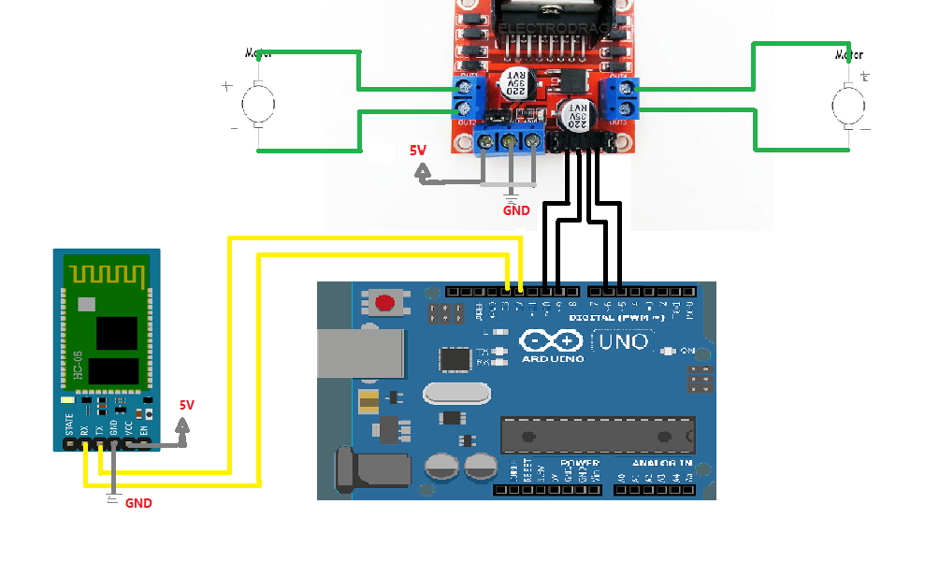
CIRCUIT DIAGRAM

Slide 19
WORKING OF RECIVER PART
In receiver circuit generally we use a ardunio with a bluetooth and the driver with the motor and some programing to control the motor and its direction .
then when the transmitter circuit gives the data in air then the receiver circuit captured those data and used our bluetooth function as a decoder .
Its decodes the data and sends 4 pin output of high or low digital signal to L298D motor driver board module.
And then the board runs the automated car in desired direction according to the gesture of the users hand

Slide 20
WHAT ARE STEPS INVOVED?
After haven brought on the components, the following steps are involved:
Firstly, we have to check if our components like the UNO and Lilypad are working properly. To do this, basic programming is uploaded in the boards.
The next step is to assemble all the component starting with the chassis, motors and wheels of the car, then the UNO, motor driver and Bluetooth module for the receiver part. For the transmitter part, mainly are the Lilypad, accelerometer, and Bluetooth module.
Using the Arduino IDE software, the code is uploaded in the boards.
Finally the assembly is checked to ensure that the connections have been properly done and then we are good to go.

Slide 21
ADVANTAGES
Simple ,fast and easy to implement and can be applied on real system .
Speed and sufficient reliable for recognition system
It is very much compact and user friendly
It has low power consumption
The system successfully recognized static and dynamic gestures

Slide 22
APPLICATION
The use of gesture recognition, remote Control with the wave of a hand of various devices is possible such as gaming to make the game player’s experience more interactive and impressive
Gesture controlling is very helpful for handicapped and physically disabled people to achieve certain tasks, such as driving a vehicle.
Wireless controlled robots are very useful in many applications like remote surveillance, military , medical etc.
Hand gesture controlled robot can be used by physically challenged in wheelchair

Slide 23
CONCLUSION
The purpose of project is to control a toy car using accelerometer sensors attached to a hand glove. The sensors are intended to replace the remote control that is generally used to run the car. It will allow us to control the forward and backward, and left and right movements, while using the same accelerometer sensor to control the throttle of the car, based on the hand movements. By using the above mentioned components the hardware was setup, thus resulting in the formation of a robot.

Slide 24
THANK YOU!!

